Slide 1
Introduction to Machine Learning

Slide 2
Companion Book
We will be using Introduction to Statistical Learning by Gareth James as a companion book.
It’s freely available online

Slide 3
Companion Book
Students who want the mathematical theory should do the reading.
Students who just want light theory and more interested in Python Applications.

Slide 4
Companion Book
Read Chapters 1 & 2 to gain a background understanding before continuing to the Machine Learning Lectures.

Slide 5
What is Machine Learning?
Machine learning is a method of data analysis that automates analytical model building.
Using algorithms that iteratively learn from data, machine learning allows computers to find hidden insights without being explicitly programmed where to look.

Slide 6
What is it used for?
Fraud detection.
Web search results.
Real-time ads on web pages
Credit scoring and next-best offers.
Prediction of equipment failures.
New pricing models.
Network intrusion detection.
Recommendation Engines
Customer Segmentation
Text Sentiment Analysis
Predicting Customer Churn
Pattern and image recognition.
Email spam filtering.
Financial Modeling

Slide 7






Machine Learning Process
Test Data
Model Training & Building
Data Acquisition
Data Cleaning
Model Testing
Model Deployment

Slide 8
Supervised Learning
Supervised learning algorithms are trained using labeled examples, such as an input where the desired output is known.
For example, a piece of equipment could have data points labeled either “F” (failed) or “R” (runs).

Slide 9
Supervised Learning
The learning algorithm receives a set of inputs along with the corresponding correct outputs, and the algorithm learns by comparing its actual output with correct outputs to find errors.
It then modifies the model accordingly.

Slide 10
Supervised Learning
Through methods like classification, regression, prediction and gradient boosting, supervised learning uses patterns to predict the values of the label on additional unlabeled data.
Supervised learning is commonly used in applications where historical data predicts likely future events.

Slide 11
Supervised Learning
For example, it can anticipate when credit card transactions are likely to be fraudulent or which insurance customer is likely to file a claim.
Or it can attempt to predict the price of a house based on different features for houses for which we have historical price data.

Slide 12
Unsupervised Learning
Unsupervised learning is used against data that has no historical labels.
The system is not told the "right answer." The algorithm must figure out what is being shown.
The goal is to explore the data and find some structure within.

Slide 13
Unsupervised Learning
Or it can find the main attributes that separate customer segments from each other.
Popular techniques include self-organizing maps, nearest-neighbor mapping, k-means clustering and singular value decomposition.

Slide 14
Unsupervised Learning
These algorithms are also used to segment text topics, recommend items and identify data outliers.

Slide 15
Reinforcement Learning
Reinforcement learning is often used for robotics, gaming and navigation.
With reinforcement learning, the algorithm discovers through trial and error which actions yield the greatest rewards.

Slide 16
Reinforcement Learning
This type of learning has three primary components: the agent (the learner or decision maker), the environment (everything the agent interacts with) and actions (what the agent can do).

Slide 17
Reinforcement Learning
The objective is for the agent to choose actions that maximize the expected reward over a given amount of time.
The agent will reach the goal much faster by following a good policy.

Slide 18
Reinforcement Learning
So the goal in reinforcement learning is to learn the best policy.

Slide 19
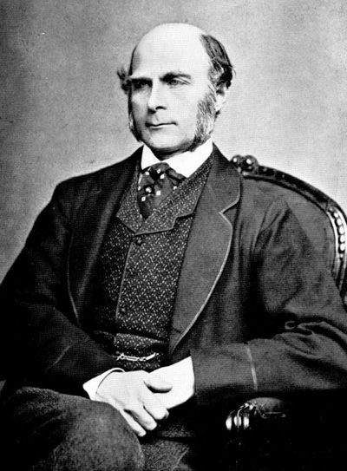
History
This all started in the 1800s with a guy named Francis Galton. Galton was studying the relationship between parents and their children. In particular, he investigated the relationship between the heights of fathers and their sons.

Slide 20
History
What he discovered was that a man's son tended to be roughly as tall as his father.
However Galton's breakthrough was that the son's height tended to be closer to the overall average height of all people.

Slide 21
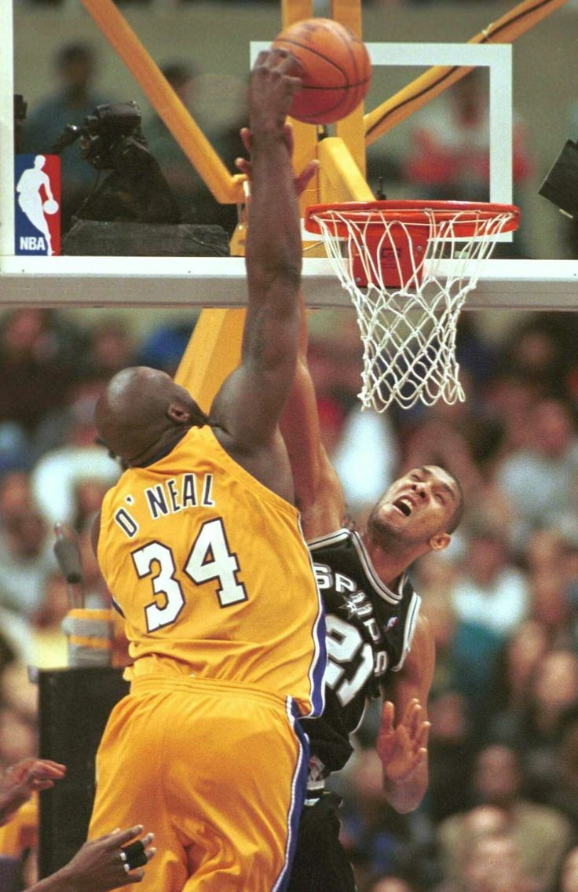
Example
Let's take Shaquille O'Neal as an example. Shaq is really tall:7ft 1in (2.2 meters).
If Shaq has a son, chances are he'll be pretty tall too. However, Shaq is such an anomaly that there is also a very good chance that his son will be not be as tall as Shaq.

Slide 22
Example
Turns out this is the case: Shaq's son is pretty tall (6 ft 7 in), but not nearly as tall as his dad.
Galton called this phenomenon regression, as in "A father's son's height tends to regress (or drift towards) the mean (average) height."

Slide 23
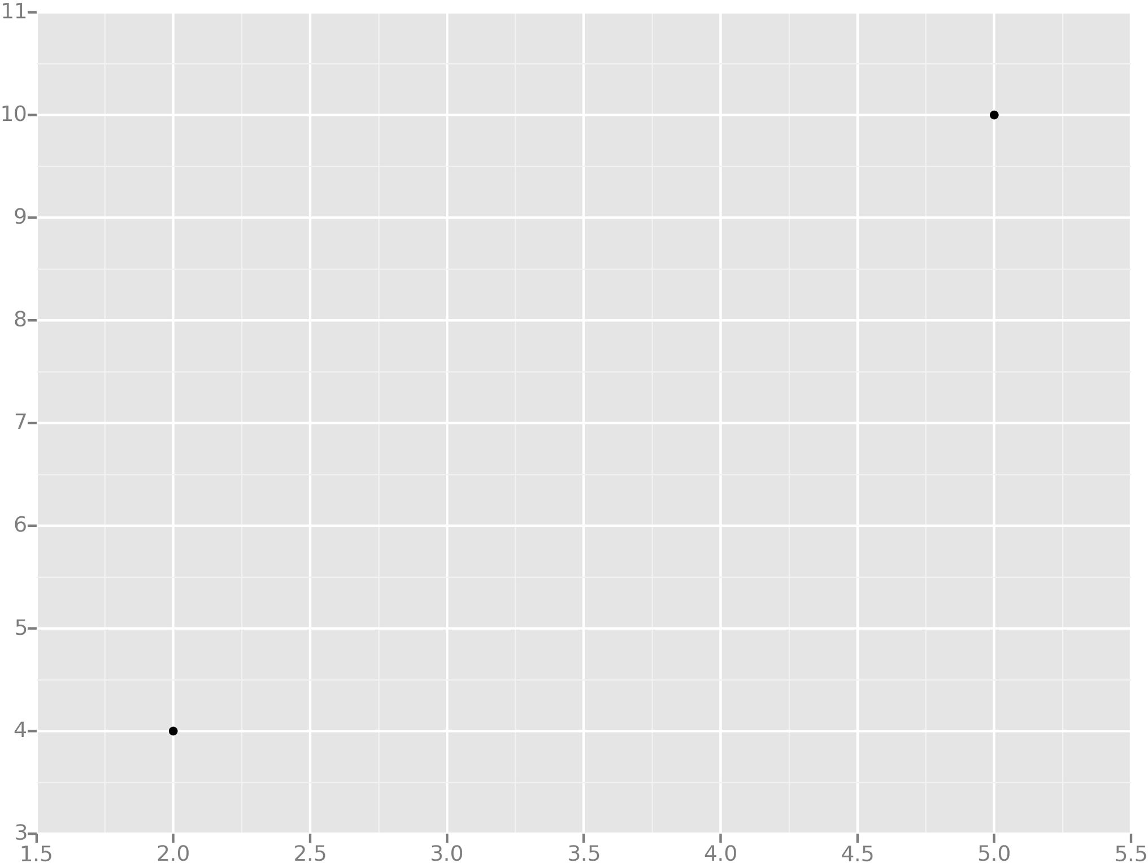
Example
Let's take the simplest possible example: calculating a regression with only 2 data points.

Slide 24
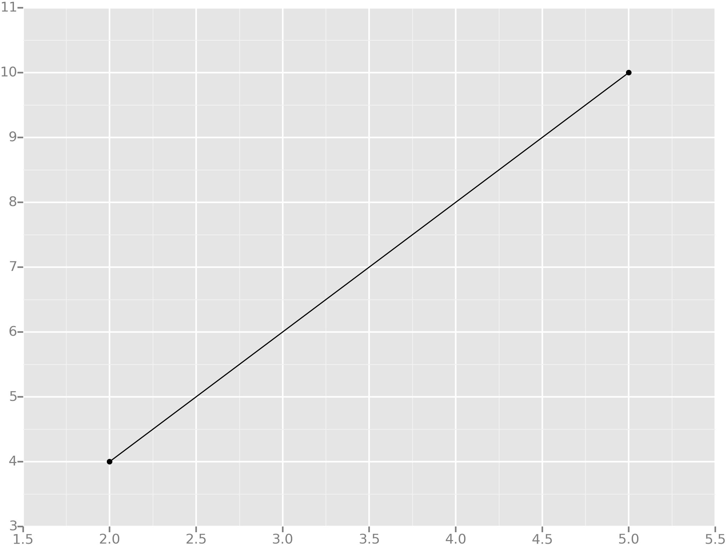
Example
All we're trying to do when we calculate our regression line is draw a line that's as close to every dot as possible.
For classic linear regression, or "Least Squares Method", you only measure the closeness in the "up and down" direction

Slide 25
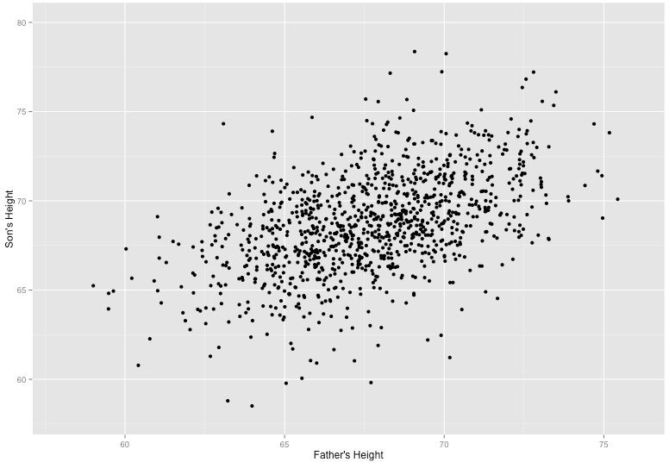
Example
Now wouldn't it be great if we could apply this same concept to a graph with more than just two data points?
By doing this, we could take multiple men and their son's heights and do things like tell a man how tall we expect his son to be...before he even has a son!

Slide 26
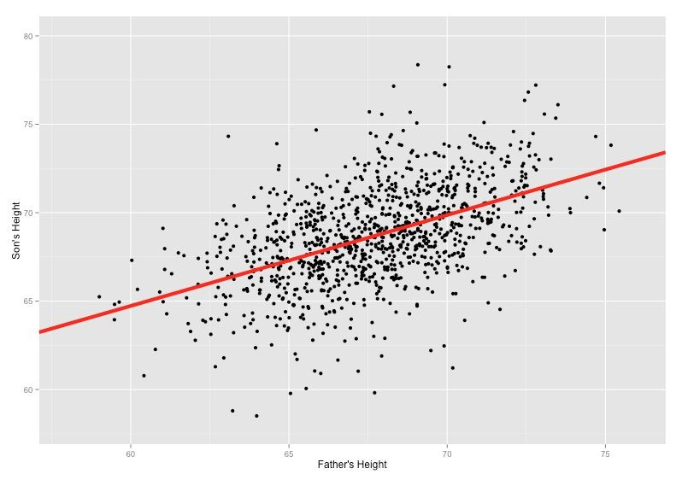
Example
Our goal with linear regression is to minimize the vertical distance between all the data points and our line.
So in determining the best line, we are attempting to minimize the distance between all the points and their distance to our line.

Slide 27
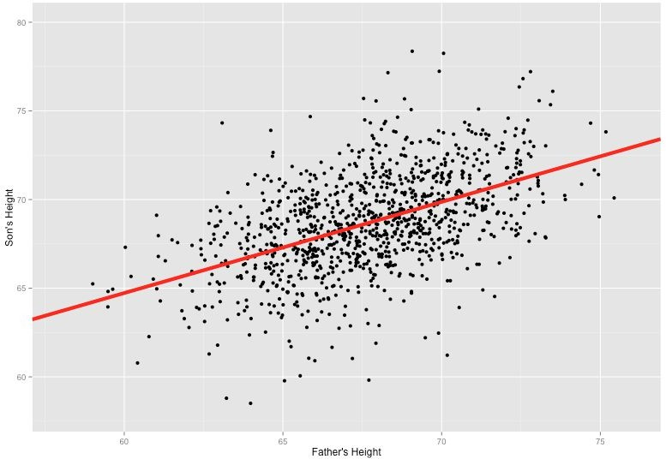
Example
There are lots of different ways to minimize this, (sum of squared errors, sum of absolute errors, etc), but all these methods have a general goal of minimizing this distance.

Slide 28




Example
For example, one of the most popular methods is the least squares method.
Here we have blue data points along an x and y axis.

Slide 29
Example
Now we want to fit a linear regression line.
The question is, how do we decide which line is the best fitting one?

Slide 30
Example
We’ll use the Least Squares Method, which is fitted by minimizing the sum of squares of the residuals.
The residuals for an observation is the difference between the observation (the y-value) and the fitted line.

Slide 31
Example with Python
In the next lecture we’ll use SciKit-Learn and Python to create a linear regression model.
Then you’ll have your own portfolio project exercise and afterwards we’ll go over the solutions to that project.

Slide 32
Let’s start using Python for Machine Learning!

Slide 33
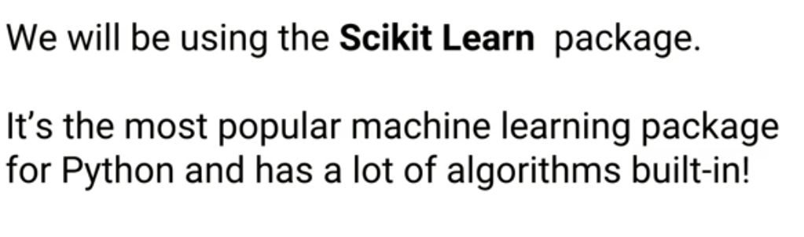
Scikit Learn

Slide 34
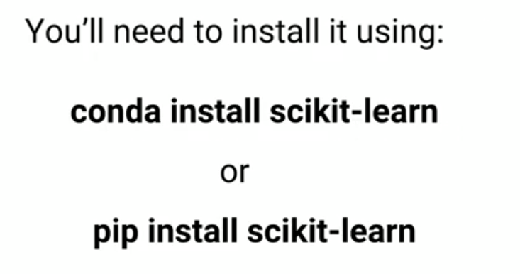
Installation

Slide 35
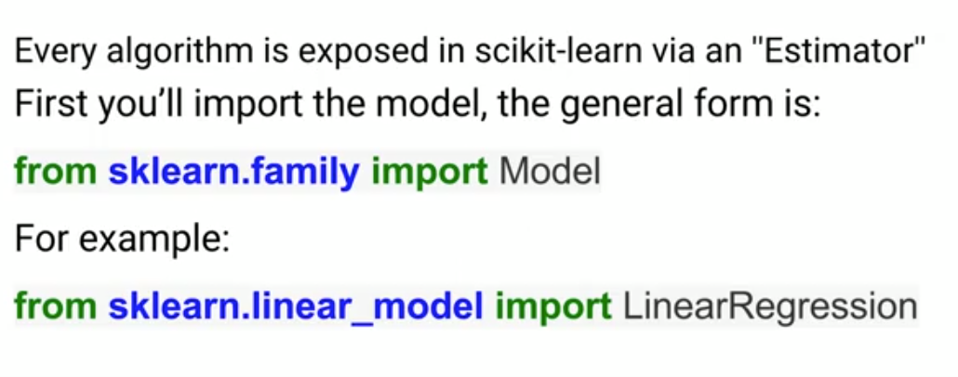
Importing Scikit Learn

Slide 36
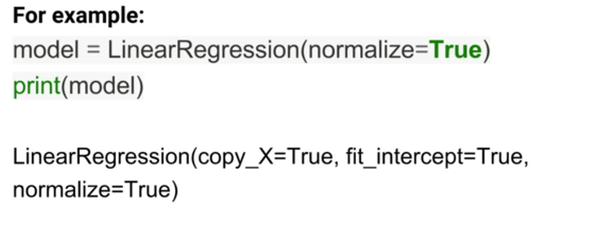
Estimators

Slide 37
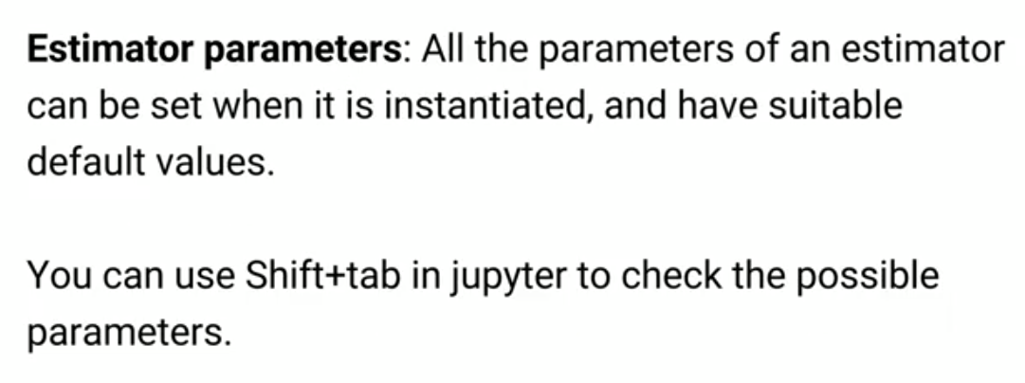
Cont..

Slide 38
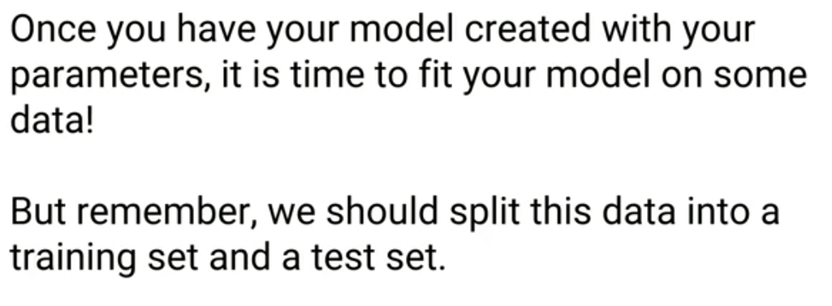

Slide 39
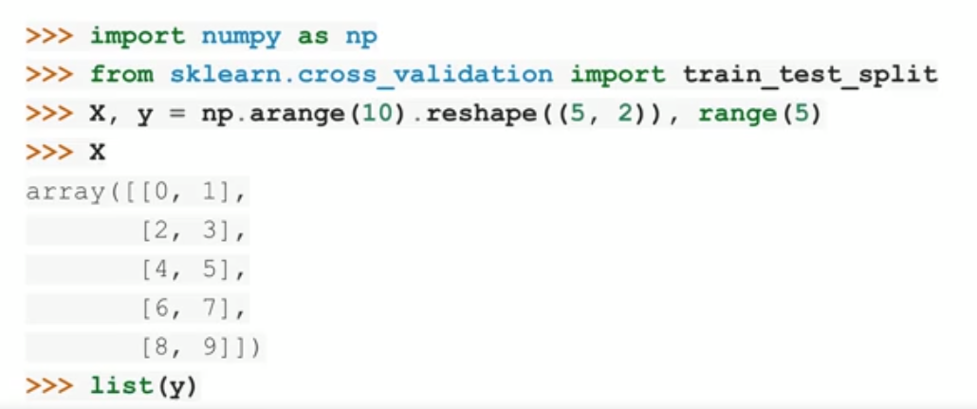
Training & Testing dataset

Slide 40
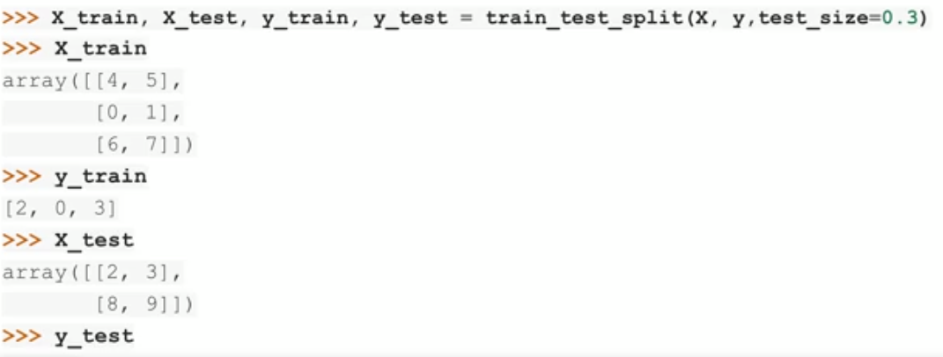
Cont..

Slide 41
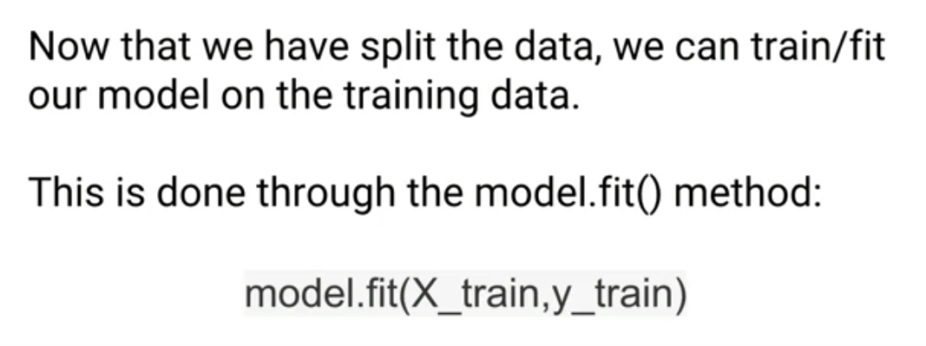
Model Fitting

Slide 42
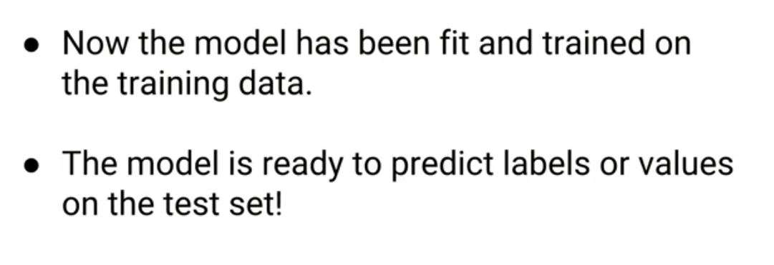
Predicitng

Slide 43
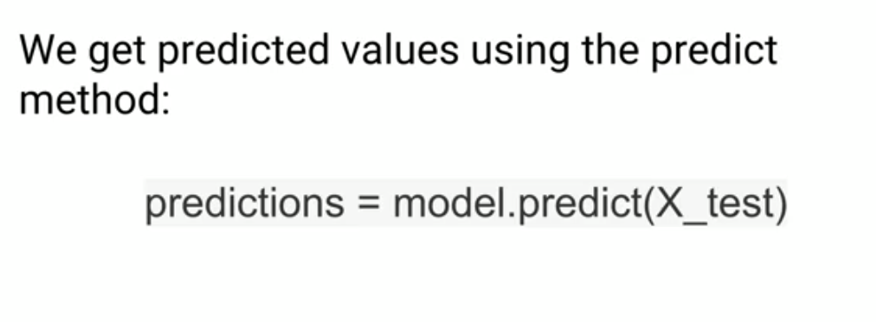

Slide 44
Deployment

